Slide 1
System and Method of Event Sequence Prediction for Anomaly Detection With Weakly Supervision

Slide 2
Background and Problem Statement
Background:
The analysis of IT log data (containing metrics collected by monitoring systems) of one running system makes it possible to detect anomalous states early, and thus to avoid further physical damage and business loss in a distributed system.
Goal:
Build a weakly supervised learning system to generate event sequence with optional a service-topology structure constraint for early detection of anomalies in IT log data of a distributed system. This will greatly help these executions in IT operations and service management, such as diagnosis, anomaly detection, fault localization, remediation of an issue, change risk assessment.
Challenges:
Many system logs are produced by several concurrently running tasks, so it cannot guarantee log messages are in order, even they all contain timestamp. However, the order of logs provides important information for diagnosis and analysis (e.g., identify the execution path of a program) [1]
The available “good quality” of event sequence paired data are not sufficient.
Auto-generated data can be partially labeled by humans’ feedback for training purposes.
Generate informative, coherent, and reasonable event sequence.
[1] Du, Min, et al. "Deeplog: Anomaly detection and diagnosis from system logs through deep learning." Proceedings of the 2017 ACM SIGSAC conference on computer and communications security. 2017.

Slide 3
Business Value
To detect anomalous states early and avoid further physical damage and business loss in the cloud environment.
Improve the accuracy of anomaly detection and speed of solving technical issues in the cloud environment.
The proposed system can detect/predict anomalies/risks before the serious problems happen that could be applied across other domains (e.g., bank transaction anomaly detection) not just cloud environment.
The proposed system can generate labeled data that could be applied to train machine learning models for other tasks across other domains (e.g., bank transaction anomaly detection) not just cloud environment.
Enable anomaly detection, data augmentation, revenue opportunities based on the adversarial reinforcement learning system.

Slide 4
Invention Summary (How)
Leverage service-topology structure (given or learned) to convert unstructured time-based event sequence to structured one in a distributed system.
Leverage service-topology structure (given or learned) to improve the beam search in order to generate more meaningful event sequences in a distributed system.
It is a weakly semi-supervised learning system, of which the core module is an adversarial reinforcement learning model to predict log event sequences using defined reward incentives trained on a historical IT log data.
Incorporating the reinforcement learning mechanism, GAN’s discriminator behaviors as a human to guide the GAN’s generator continuously improve its performance on log event sequence generation.

Slide 5
Novelty (Claims)
It is an anomaly prediction system based on adversarial reinforcement learning.
It leverages service-topology structure (given or learned) to generate event sequence data.
It can detect the faults or even unknown types of anomalies early based on previous input event sequence data.
No need to use massive sets of hand-labeled training data (i.e., weakly supervised learning).
An inline and self-improved adversarial reinforcement learning engine, which can derive and inference from generated event sequences to improve the performance of anomaly prediction in the cloud environment.

Slide 6





Process Overview
Historical
Operational Records with or w/o distributed system topology information
Data
Preprocessing
Topology? no
Discover Microservices Topology
Offline Training
Event Sequence Generation Engine
Topology? Yes
Event Sequence Conversation
preprocessing
En
De
-----------------------------In-line processing ---------------------------------------------------------------------------------------------------------
The t-th time window’s event sequence e_1,t, e_2,t …
Event Sequence Generation Engine
preprocessing
Run-time IT operations artifacts
En
De
New event sequence conversation,
Prediction
Event Sequence Conversation
feedback
Weakly Supervised Learning Cycle
SMEs

Slide 7
Process Overview
Offline Training
Historical
Operational Records with or w/o distributed system topology information
Discover Microservices Topology
Generator
Data Preprocessing
Topology? no
Event Sequence Conversation
En
De
Topology? Yes
preprocessing
Event sequence in (t-1)th time window
Runtime
Real time sequences of events
Event Sequence Conversation
Discriminator
Alert if it predicts anomalies.
Event sequence in (t)th time window

Slide 8
Data Preprocessing
Remove repeated data and noise/special characters from historical log data.
Replace some unique tokens in an event with the defined fixed token in order to reduce the vocabulary size (the domain specific vocab).
Process each log entry to log template.
for example:
Log entry e = “CPU usage is 95%.” -> “CPU usage is *%.”
each log template is represented by an embedding vector using the domain-specific vocab, which is sparse. [2]
[2] Roy, Arpita, Youngja Park, and Shimei Pan. "Incorporating domain knowledge in learning word embedding." 2019 IEEE 31st International Conference on Tools with Artificial Intelligence (ICTAI). IEEE, 2019.

Slide 9
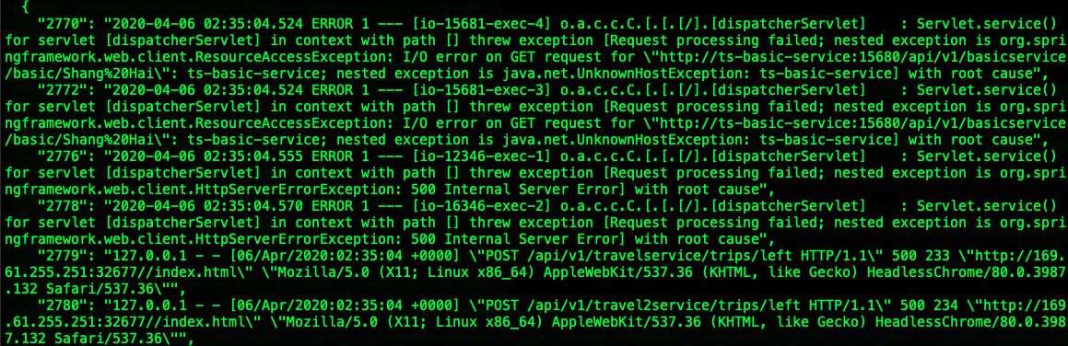
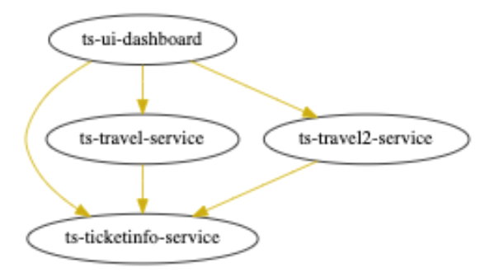
An example of “event sequence conversation”
ts-ui-dashboard sends the travel information to ts-travel-service
ts-travel-service sends the source and destination station details to ts-ticketinfo-service
ts-ticketinfo-service sends the ticket information to ts-travel-service
Language is a set of valid sentences, but what makes a sentence valid? syntax and semantics.
A part of microservices architecture (a distributed system) of a publicly benchmark train-ticket system
Partial logs of error propagation among microservices ts-ticketinfo-service, ts-travel-service, ts-travel2-service and, ts-ui-dashboard.

Slide 10
An example of “event sequence conversation”
HDFS log data set
It is generated through running Hadoop-based map-reduce jobs on more than 200 Amazon’s EC2 nodes, and labeled by Hadoop domain experts.
number of sessions: 4,855, number of sequence pairs: 41,856
11 9 26 26 26 appears 3,129 times in training dataset (41,856)
11 is the log template id.
The log id sequence is reorganized based on the workflow.
11 9 26 26 26 2 23 23 23 21 : appears 86 times in training dataset
11 9 26 26 26 3 3 4 3 3 : appears 40 times in training dataset
11 9 26 26 26 23 23 23 21 21 : appears 1,770 times
11 9 26 26 26 3 4 3 3 3 : appears 27 times
11 9 26 26 26 3 4 3 3 4 : appears 23 times
…

Slide 11
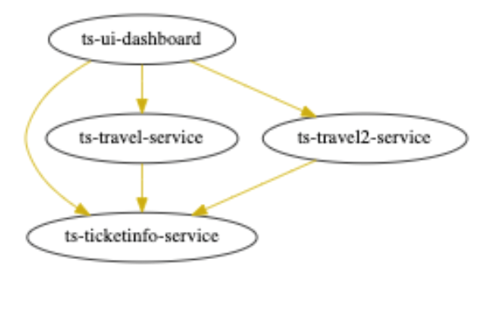
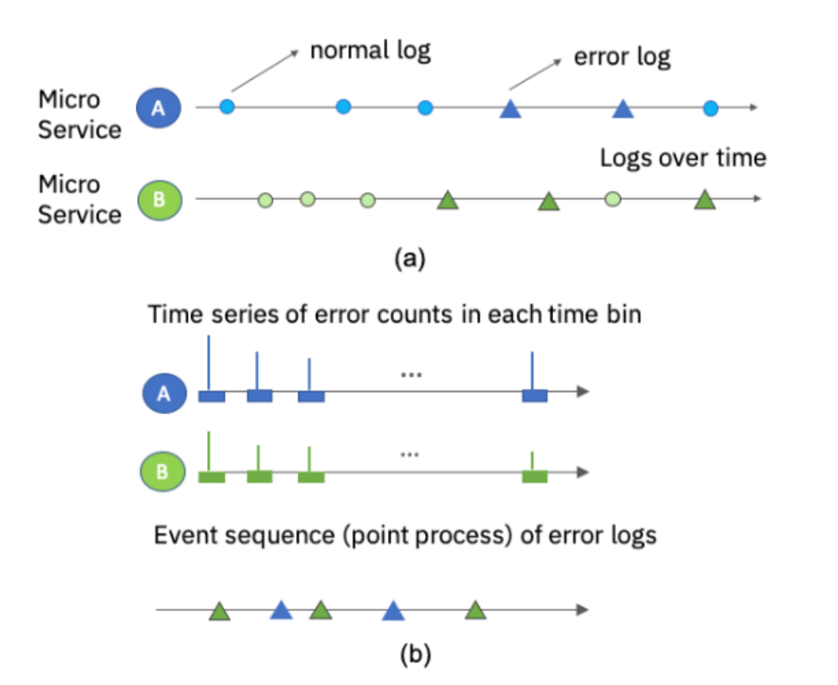
Event Sequence Conversation: Convert Time-based Log Data to Structured Event Sequence
1
If distributed system topology is not given, causality methods can be applied to generate a topology graph from time-based log data
An example of a learned distributed system topology / causality graph
events at t_th time window
distributed system topology
2
We want to predict the event sequence at (t+1)th time window.
The t-th time window:
time-based event sequence of log data
Event logs are detected
Training data:
The t time window: structured event sequence
….
t time window: structured event sequence
(t+1) time window: structured event sequence
….
"Event sequence conversation"

Slide 12



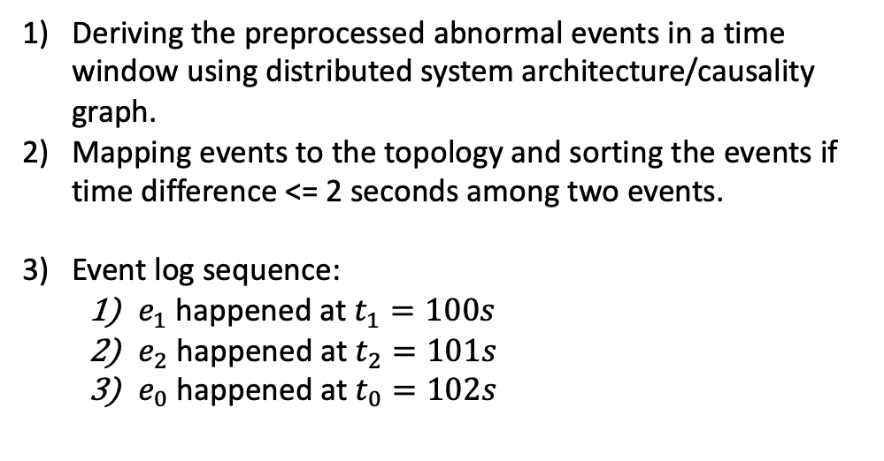








An example of Event Sequence Conversation: Convert Time-based Log Data to Structured Event Sequence
Root cause: ts-ticketinfo-service unavailable
Deriving the preprocessed abnormal events in a time window using distributed system architecture/causality graph.
Mapping events to the topology and sorting the events if time difference <= 2 seconds among two events.
Event log sequence:
$e_{1}$ happened at $t_{1}=100s$
$e_{2}$ happened at $t_{2}=101s$
$e_{0}$ happened at $t_{0}=102s$
client workload
Http-request
$e_{3}$
$e_{1}$
$e_{2}$
$e_{0}$
$e_{1}$
$e_{2}$
$e_{0}$
Time window t
$e_{0}$
$e_{1}$
$e_{2}$

Slide 13

Event Sequence Generation Engine
h
Discriminator
En
De
x
scalar
Event Sequence Generator
reward
update parameters
$$θ$$
h: real data
x: data generated by Generator.
use the output of Discriminator as reward
update generator to increase discriminator to get maximum reward
Agent: a generative model actor-critic based
State: generated tokens
Action: next token to be generated
Reward:
1) feedback given by a discriminate model predict state-action value by Monte Carlo Search.
2) sequence reward: the number of correct ordered pair events of generated event sequence based on the topology.

Slide 14
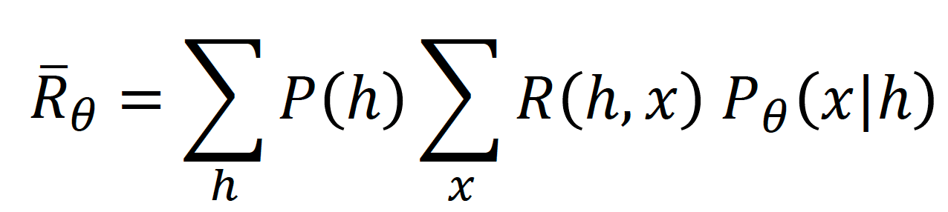
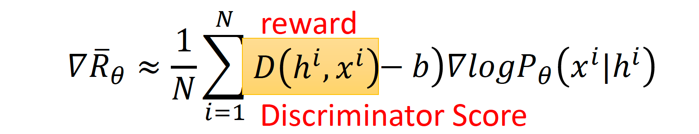
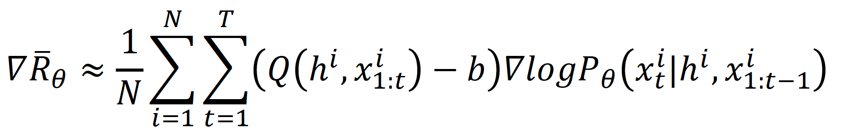



Rewarding an event sequence or a token (i.e., an event)
Consider an event sequence example in a time window:
Each event is a token.
$h^{i}$=
$x^{i}$=
Objective Function:
$e_{0}$ , $e_{2}$
$e_{3}$ , $e_{1}$
Reward at the event sequence level:
(
Reward at the event token level:

Slide 15
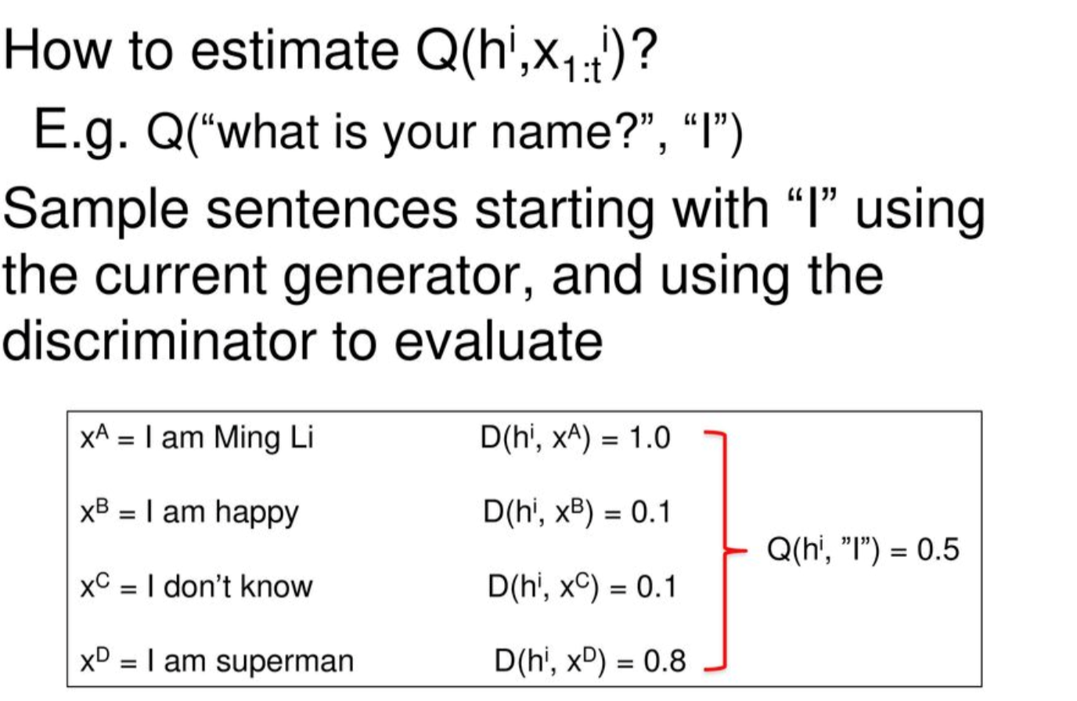
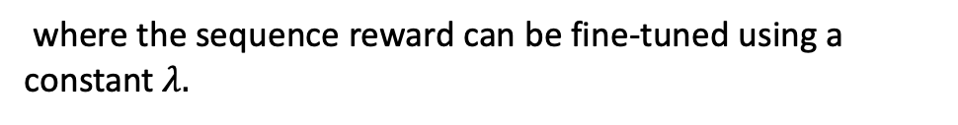

Monte Carlo estimation of Q value
2) Event Sequence reward: the number of correct ordered pair events of generated event sequence based on the topology.
$$+λ r_{order}(x^{i})$$
(
where the sequence reward can be fine-tuned using a constant $λ.$
An example of natural language generation using Monte Carlo sampling (Q value)
$r_{order}\left(x^{i}\right)=\frac{the number of ordered event pairs in { x}^{i}}{the total number of ordered event pairs in the topology (hops=1) }$

Slide 16
Anomaly detection
sequences of events
Discriminator
score for the pair sequences, e.g., D(h, x)
Generator and Discriminator are trained using GAN architecture to produce “normal” event sequence
During inference Discriminator receives a “real-world” event sequence and provides a feedback on the probability of this sequence event - D(h, x)
System has a threshold for an acceptable score
Low probability means that the sequence might be abnormal
In case of the anomaly, sequence with a lowest score among neighbors is reported
A normal sequence means it is a frequent sequence in the dataset.
e.g., h = (a, b, c) x = (d, f) and D(h, x) = 1; but the observed sequence z = (d). We could guess if there is anomaly by calculating D(h, z) using the well-learned Discriminator.

Slide 17
Background Art 1
Research Paper:
SeqGAN: Sequence Generative Adversarial Nets with Policy Gradient
Abstract: As a new way of training generative models, Generative Adversarial Net (GAN) that uses a discriminative model to guide the training of the generative model has enjoyed considerable success in generating real-valued data. However, it has limitations when the goal is for generating sequences of discrete tokens. A major reason lies in that the discrete outputs from the generative model make it difficult to pass the gradient update from the discriminative model to the generative model. Also , the discriminative model can only assess a complete sequence, while for a partially generated sequence, it is non-trivial to balance its current score and the future one once the entire sequence has been generated. In this paper, we propose a sequence generation framework, called SeqGAN, to solve the problems. Modeling the data generator as a stochastic policy in reinforcement learning (RL), SeqGAN bypasses the generator differentiation problem by directly performing gradient policy update. The RL reward signal comes from the GAN discriminator judged on a complete sequence, and is passed back to the intermediate state-action steps using Monte Carlo search.
Differences:
This paper describes a model for generating structured sequence using natural language.
It doesn't consider the topology information, but we need first to construct the structured event sequence and also use it for reward function.

Slide 18
Background Art 2
Research Paper: Log File Anomaly Detection
Abstract:
Analysis of log files pertaining to a failed run can be a tedious task, especially if the file runs in to thousands of lines. Using the recent development in text analysis using deep neural networks, we present a method to reduce effort needed to analyze the log file by highlighting the most probably useful text in the failed log file, which can assist in debugging the causes of the failure. In essence, we reduce the log file by removing the lines which are found to be of less importance to the debug. We measure the accuracy of our reduction by F1 score, as well as custom scoring method on manually labeled data, where important lines from a ’failed’ log are extracted by the experts of the domain.
Differences:
This paper uses the language model to reduce the log files that are not important for debugging.
It doesn't consider the feedback mechanism in their seq2seq proposed model.
It needs large amount of labeled data.

Slide 19
Background Art 3
Patent: Unsupervised anomaly detection using generative adversarial networks
Abstract: A method, system and computer program product, the method comprising: mutually training, using feedback, a generator and a discriminator of a conditional adversarial generative adversarial networks using training item groups, each item group representing events in a time window, the generator comprises a generator Recurrent Neural Network (RNN), the discriminator comprises a discriminator RNN; receiving by the discriminator, discrete sequential data comprising a sequence of item groups comprising an item group representing events in a time window, and item groups representing events in preceding time windows; altering the sequence of item groups into collections of real numbers and providing them to the discriminator RNN; processing the collections by the discriminator RNN to obtain a probability for the item group to comprise an anomaly, in an unsupervised manner; and providing output to a user, the output based on the probability and indicative of a label for the discrete sequential data.
Differences:
This disclosure comes up with a GAN-based system that can do detect anomaly.
It doesn't consider the feedback mechanism in their proposed GAN model.
It doesn’t consider the topology information.

Slide 20
Thanks!

